Slide 1
CLASSIFY IMAGES (CIFAR-10) USING CNNs
Submitted By-
Aditya Rathor (2K21/IT/14)
Vicky Kumar (2K21/CO/513)
Submitted To-
Mrs Khushbu Gupta

Slide 2
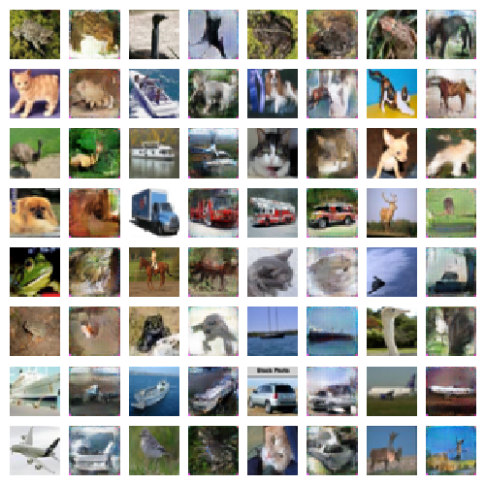
Introduction to the CIFAR-10 dataset
The CIFAR-10 dataset is a popular benchmark for image classification tasks. It consists of 60,000 color images, divided into 10 distinct classes, with each class having 6,000 images.

Slide 3
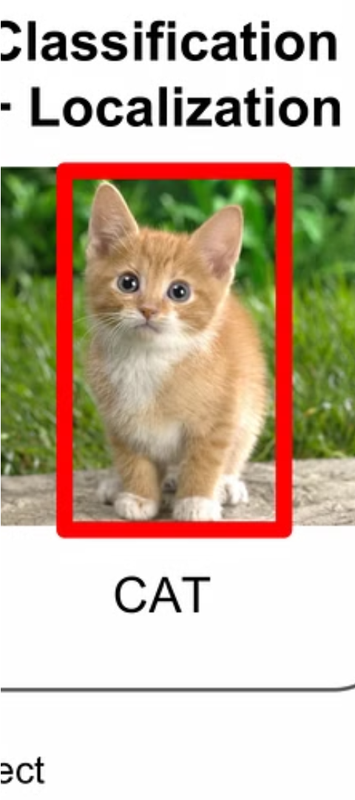

Overview of the Image Classification Problem
Categorizing Visual Data
Challenging Yet Powerful
Image classification involves assigning a label or category to an input image, such as identifying the object, scene, or activity depicted.
While seemingly simple, image classification is a complex task that requires sophisticated machine learning models to accurately recognize patterns and features in diverse visual data.
Real-World Applications
Image classification has a wide range of practical applications, from autonomous driving to medical diagnosis to content moderation and beyond.

Slide 4
Convolutional Neural Network (CNN) Architecture
Convolutional Layers
Pooling Layers
Fully Connected Layers
Activation Functions
Pooling layers reduce the spatial dimensions of the feature maps, providing a form of spatial invariance and reducing the number of parameters in the network.
The core of a CNN is its convolutional layers, which apply learnable filters to the input image. These filters capture local spatial patterns, allowing the network to identify relevant visual features.
At the end of the CNN architecture, fully connected layers combine the learned features to produce the final classification output.
Non-linear activation functions, such as ReLU, are applied after each convolutional and fully connected layer to introduce non-linearity and improve the network's ability to learn complex patterns.

Slide 5
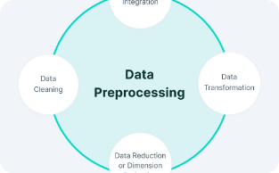
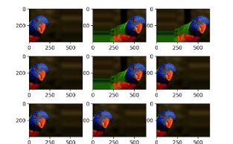
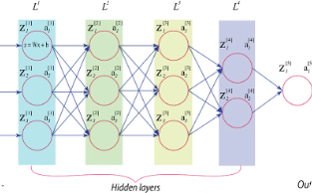
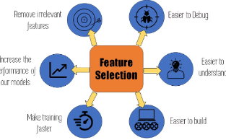
Data preprocessing and augmentation
Data Preprocessing
Data Augmentation
Normalization
Feature Engineering
Normalize pixel values to a common range, such as 0 to 1, to help the model converge more efficiently during training.
Cleanse and standardize the CIFAR-10 dataset to ensure consistent image size, pixel values, and format for efficient model training.
Apply techniques like rotation, flipping, and scaling to artificially expand the dataset, improving the model's ability to generalize and prevent overfitting.
Extract and select relevant features from the images to provide the most informative inputs to the CNN model.

Slide 6
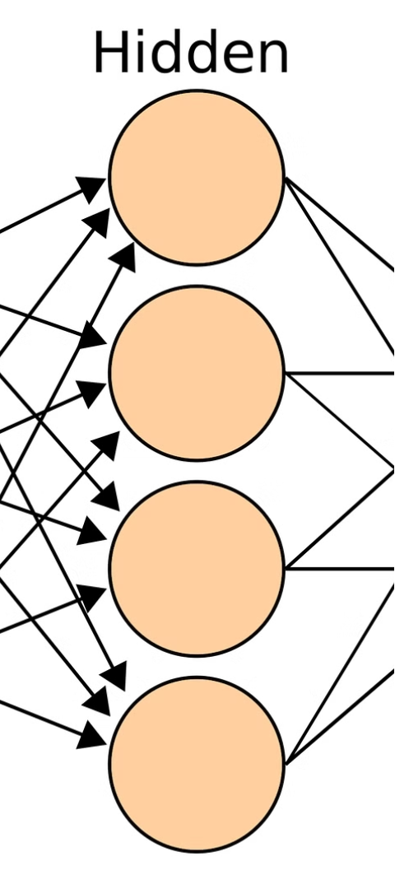
Training the CNN Model
1
Data Preparation
Split the CIFAR-10 dataset into training, validation, and test sets. Normalize pixel values and apply data augmentation techniques to expand the training data.
2
Model Architecture
Design a Convolutional Neural Network (CNN) with multiple convolutional, pooling, and fully connected layers. Choose appropriate activation functions, regularization methods, and an efficient optimizer.
3
Training Loop
Train the CNN model using the prepared training data. Monitor performance on the validation set and adjust hyperparameters as needed to improve accuracy and prevent overfitting.

Slide 7




Hyperparameter Tuning and Optimization
Learning Rate
1
Adjust the step size for gradient updates
2
Batch Size
Determine the number of samples per training step
3
Epochs
Set the number of complete passes through the dataset
4
Regularization
Prevent overfitting by adding constraints
Hyperparameter tuning is crucial for optimizing the performance of the CNN model. We explored various combinations of learning rate, batch size, number of epochs, and regularization techniques to find the optimal configuration for our CIFAR-10 image classification task. This iterative process allowed us to balance model complexity, generalization, and training efficiency.

Slide 8
Evaluating the Model's Performance
1
Accuracy and Loss Metrics
2
Confusion Matrix Analysis
Closely tracked the model's training and validation accuracy, as well as its loss on both datasets to monitor for overfitting or underfitting.
Examined the confusion matrix to identify any classes that were frequently misclassified and pinpoint areas for improvement.
3
Inference on Test Data
4
Visualization and Interpretation
Ran the trained model on the held-out test set to get an unbiased evaluation of its real-world performance.
Visualized feature maps and activation patterns to gain insights into how the model was learning to classify the images.

Slide 9
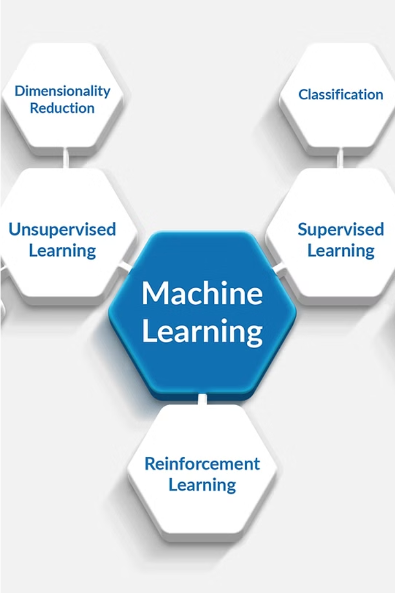
Analyzing the Model's Strengths and Weaknesses
By closely examining the performance and behavior of the CNN model, we can uncover its key strengths as well as areas for potential improvement. This analysis provides valuable insights to enhance the model's accuracy and robustness.
The model's strong performance on certain CIFAR-10 image classes suggests it has learned robust visual features for those categories. However, the lower accuracy on other classes indicates opportunities to improve the model's ability to distinguish more challenging image types.

Slide 10




Potential Improvements and Future Work
Expand Dataset
Explore Advanced Architectures
Optimize Hyperparameters
Collect more diverse and representative data to improve model performance and generalization.
Investigate state-of-the-art CNN models and techniques like transfer learning to further enhance classification accuracy.
Fine-tune hyperparameters like learning rate, batch size, and regularization to achieve optimal model convergence.

Slide 11

Conclusion and key takeaways
In conclusion, this project has successfully demonstrated the power of convolutional neural networks in classifying images from the CIFAR-10 dataset. The model achieved strong performance, highlighting the effectiveness of the chosen CNN architecture and the importance of data preprocessing and hyperparameter optimization.
Key takeaways from this work include the value of comprehensive image augmentation techniques, the significance of diligent model tuning, and the potential for further improvements through novel architectural designs or ensemble methods. Moving forward, this project lays a solid foundation for exploring more advanced computer vision applications.

